Slide 1
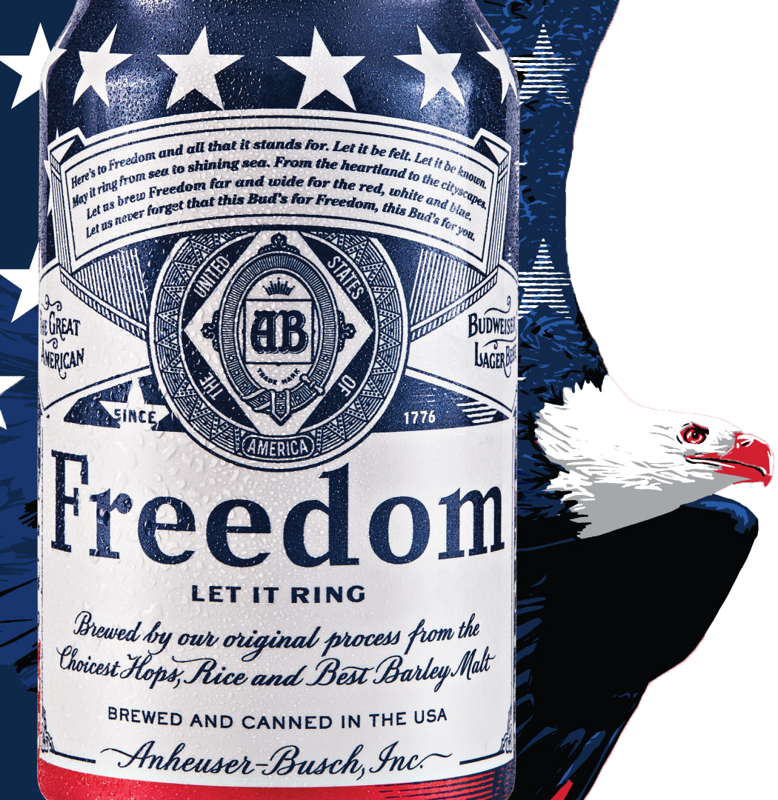

Budweiser:
“The Beers Dataset”
EXPLORATORY DATA ANALYSIS

Slide 2

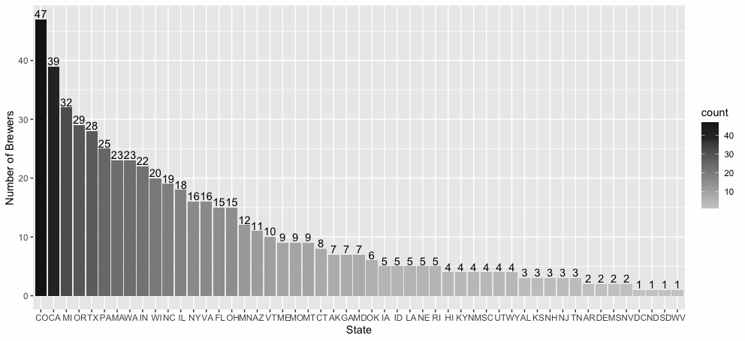
How many Breweries in each State?

Slide 3
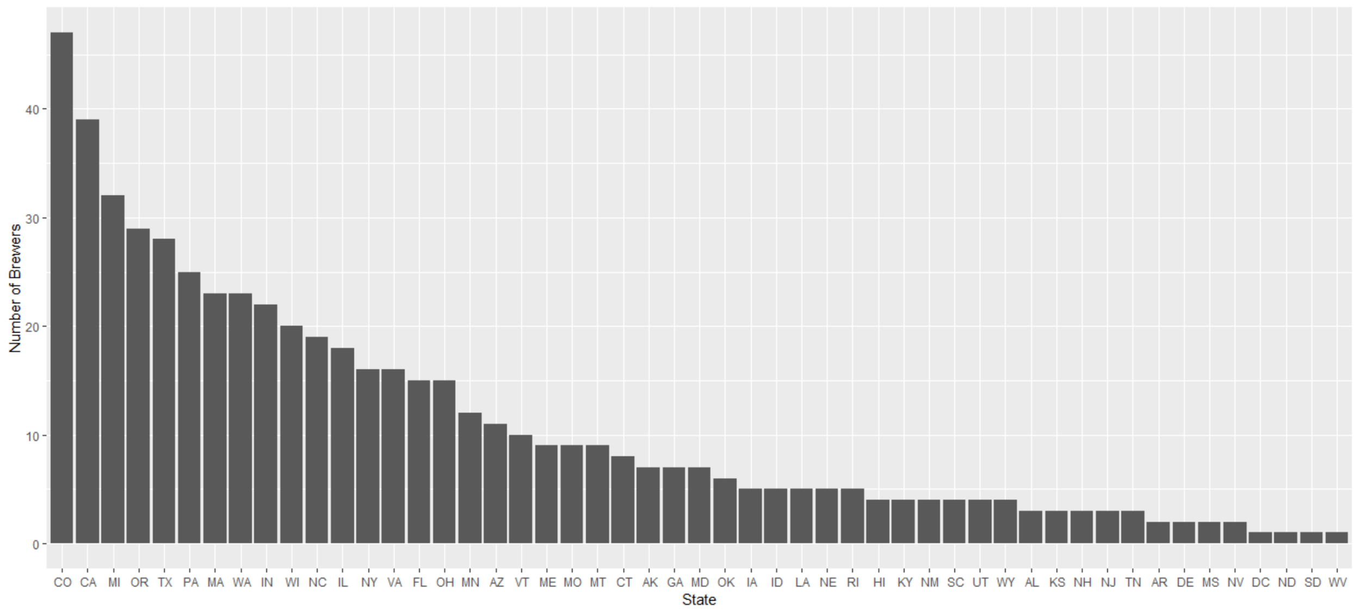
How many Breweries in each State?

Slide 4
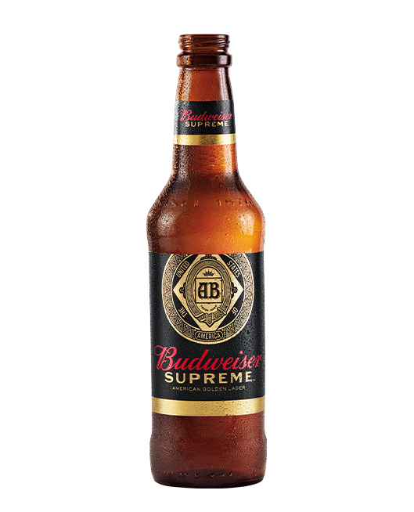
Other Exploratory Data Analysis
Discovering missing values
Our Data Scientists identified 3% of Alcohol By Volume (ABV) of the beer data points are missing (62 data points)
We also identified 50% of International Bitterness Units (IBU) of the beer data points are missing (1,000 data points)
Handling missing values
There is no relationship between the missing data in ABV and other attributes or values observed within the given dataset
There are 1,000 good quality data points that remain
Highest ABV
Without removal of all missing values in ABV or IBU
With removal of all missing values in ABV or IBU
Highest IBU
Regardless of missing values, Oregon has beer with the highest IBU
State | Highest ABV | Number of Beers
Colorado | 0.128 | 250
State | Highest ABV | Number of Beers
California | 0.099 | 135
State | Highest IBU | Number of Beers
Oregon | 138 | 87

Slide 5
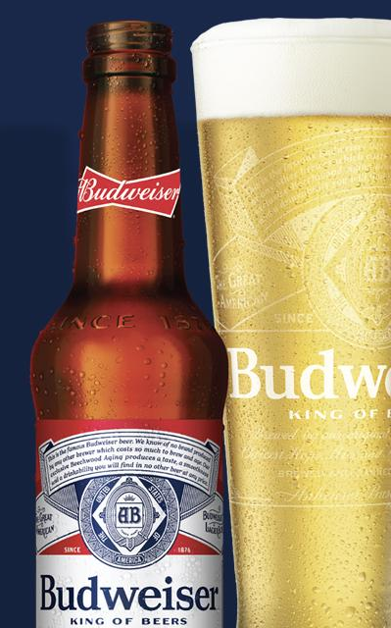
Missing Values

Slide 6
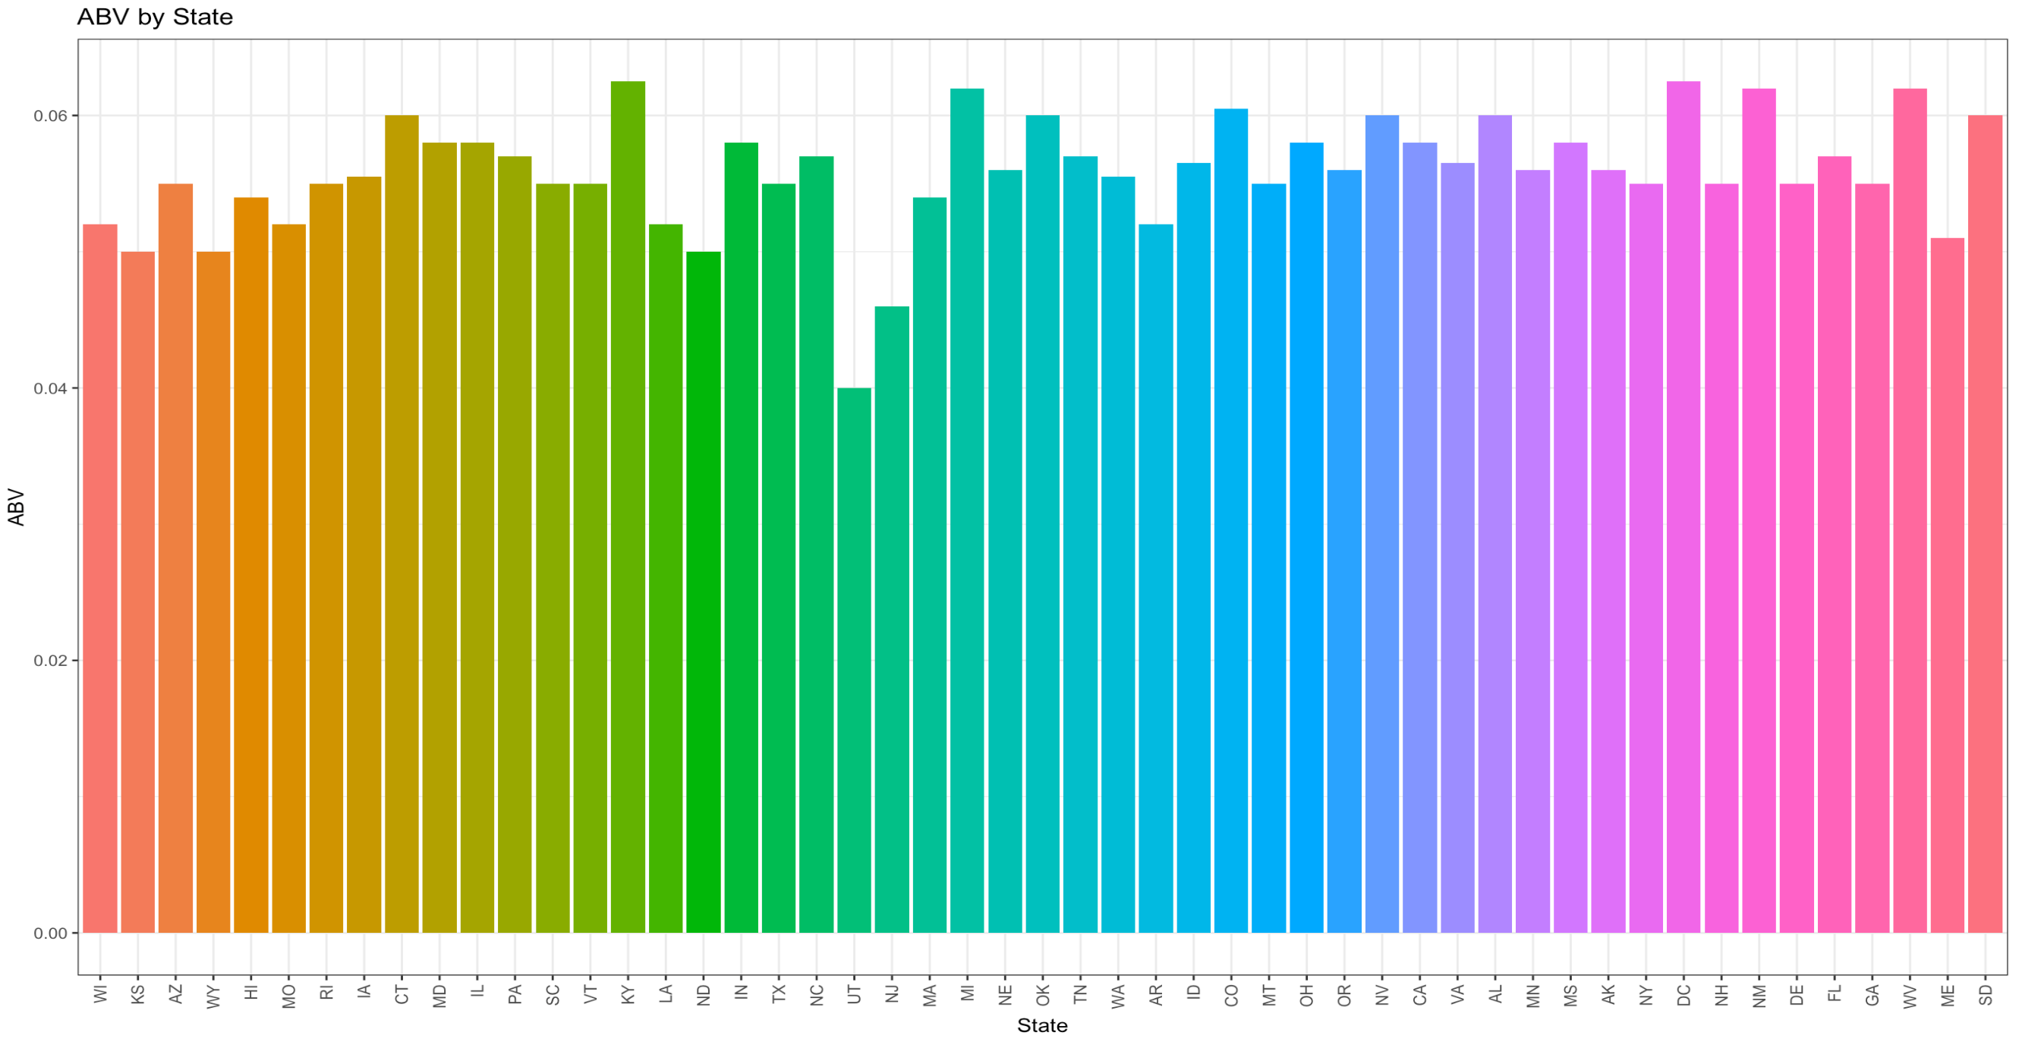
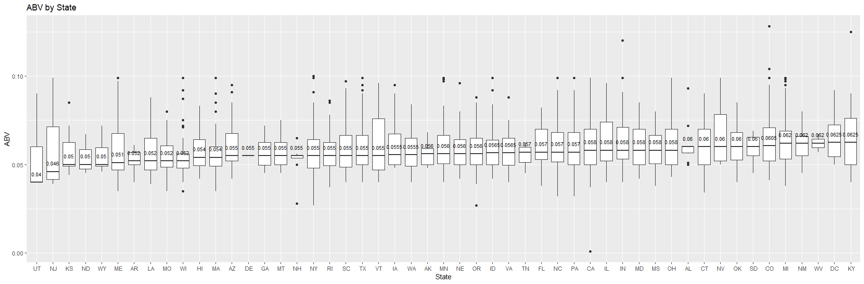
ABV by State
A bar chart of the median Alcohol Content by Volume.

Slide 7
ABV by State

Slide 8
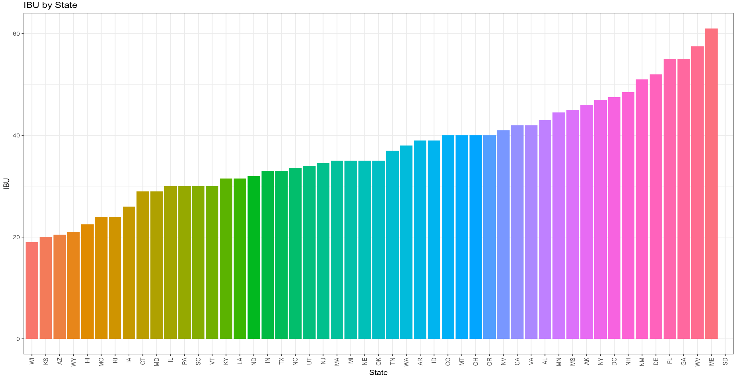
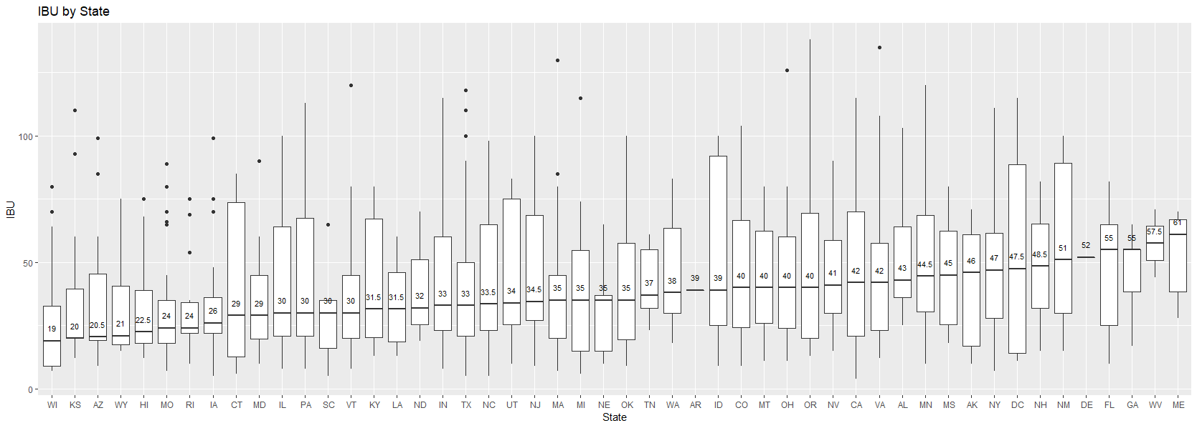
IBU by State
A bar chart of the median International Bitterness Units.
*Note: 1 row containing missing data was removed.

Slide 9
IBU by State

Slide 10
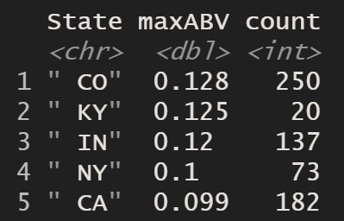
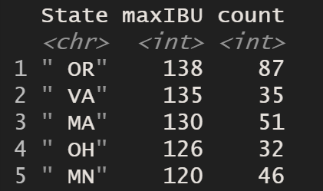
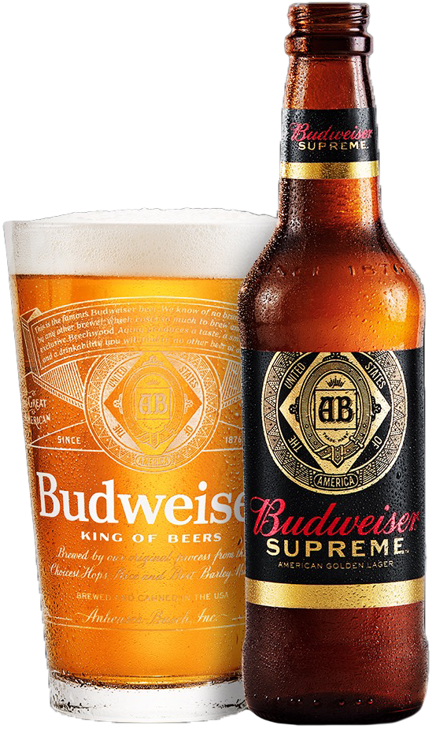
Max ABV and IBU
 | State <chr> | maxABV <dbl> | count <int>
1 | “ CO” | 0.128 | 250
2 | “ KY” | 0.125 | 20
3 | “ IN” | 0.12 | 137
4 | “ NY” | 0.1 | 73
5 | “ CA” | 0.099 | 182
 | State <chr> | maxABV <dbl> | count <int>
1 | “ OR” | 138 | 87
2 | “ VA” | 135 | 35
3 | “ MA” | 130 | 51
4 | “ OH” | 126 | 32
5 | “ MN” | 120 | 46

Slide 11
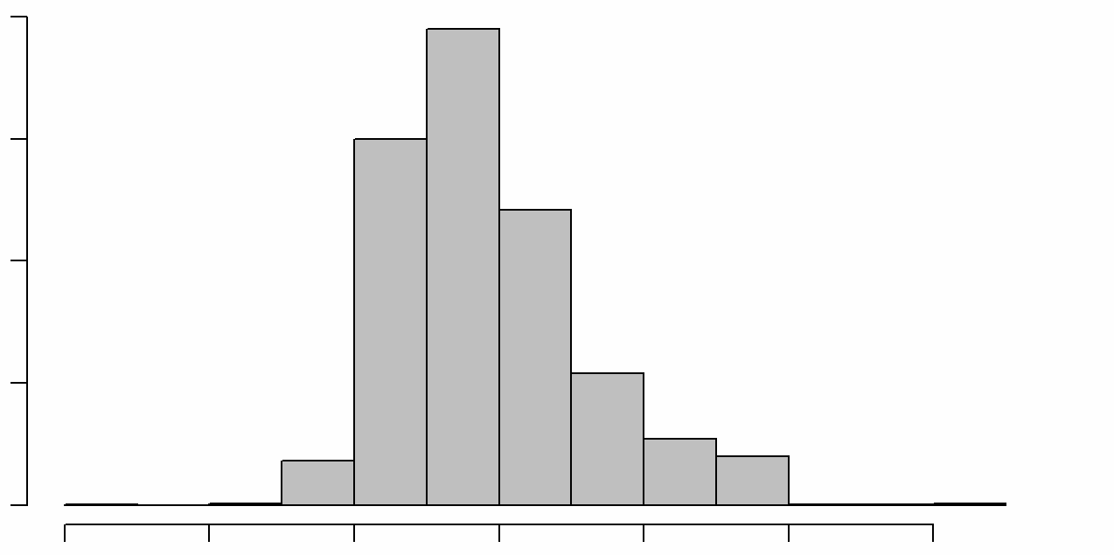
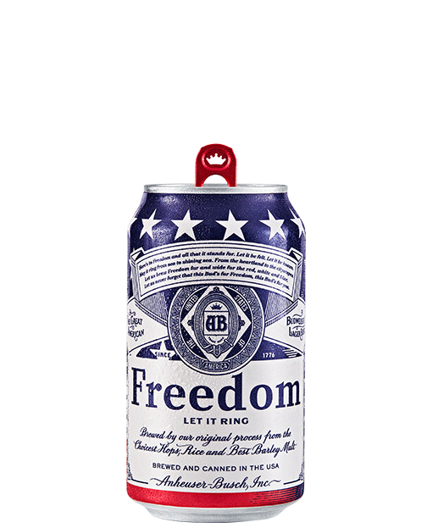
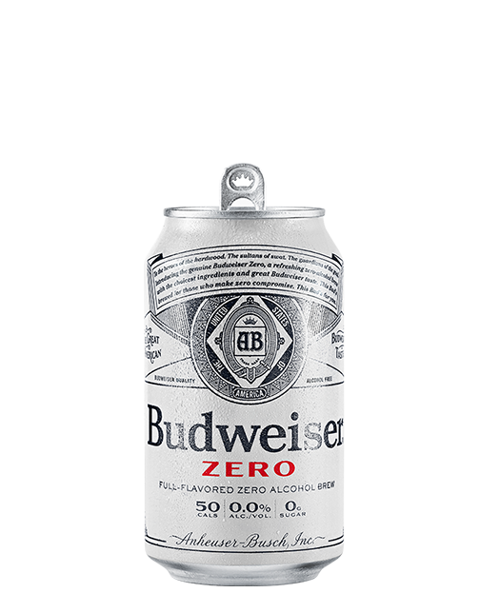
Total ABV statistics
Alcohol by volume of the beer has a mean of 0.06 with a standard deviation of 0.01. The histogram shows that the data is slightly skewed to the right, or more specifically the data is positively skewed.
800
600
Frequency
400
200
0
0.00
0.02
0.04
0.06
0.08
0.10
0.12
ABV

Slide 12
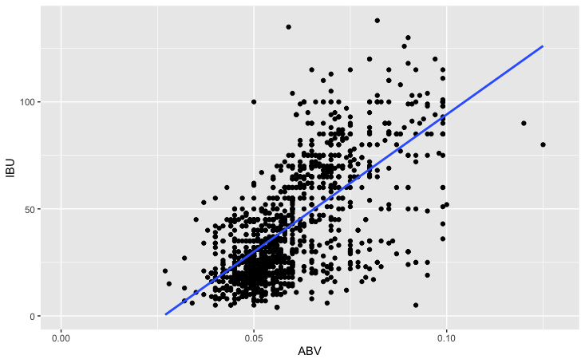
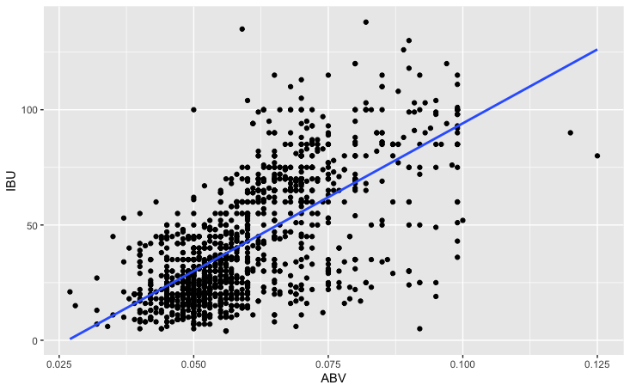
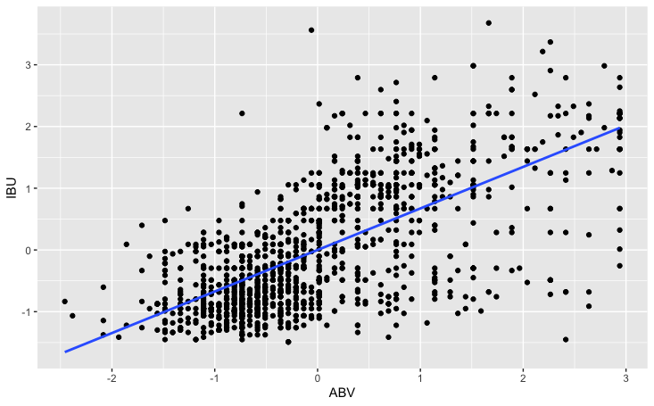
Relationship between ABV and IBU
Full Dataset
Removed NAs in ABV or IBU
Removed ABV values > 0.099 and Scale
Slope*100 | 0.0351
R-Square | 0.4493
P-value | < 2.2e-16
Slope*100 | 0.6706
R-Square | 0.4493
P-value | < 2.2e-16
Slope*100 | 0.6729
R-Square | 0.4524
P-value | < 2.2e-16
ABV and IBU have positive correlation but it shows slight increment of relationship after removing outliers and scaling ABV and IBU

Slide 13
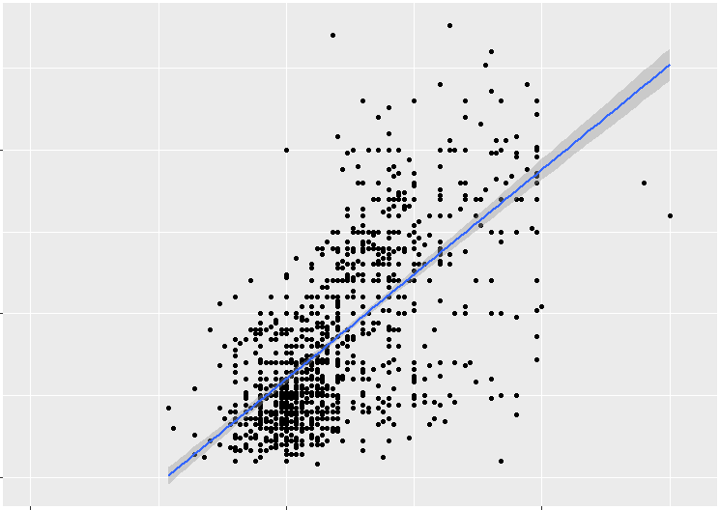
ABV and IBU correlation
100
IBU
50
0
0.00
0.05
0.10
ABV

Slide 14
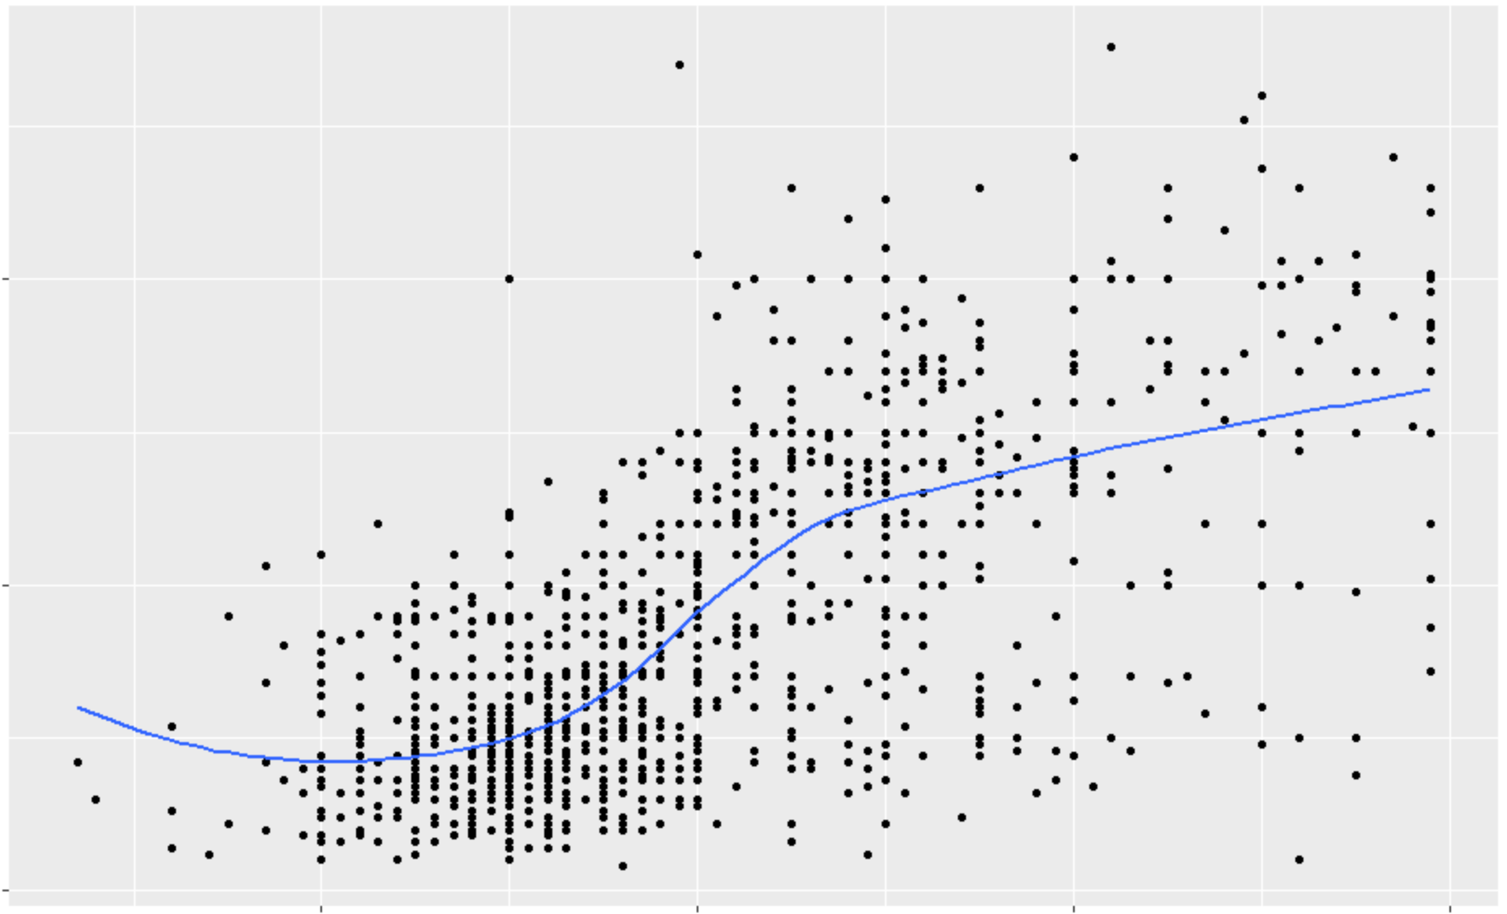
ABV and IBU correlation
100
IBU
50
0
0.04
0.05
0.08
0.10
ABV

Slide 15
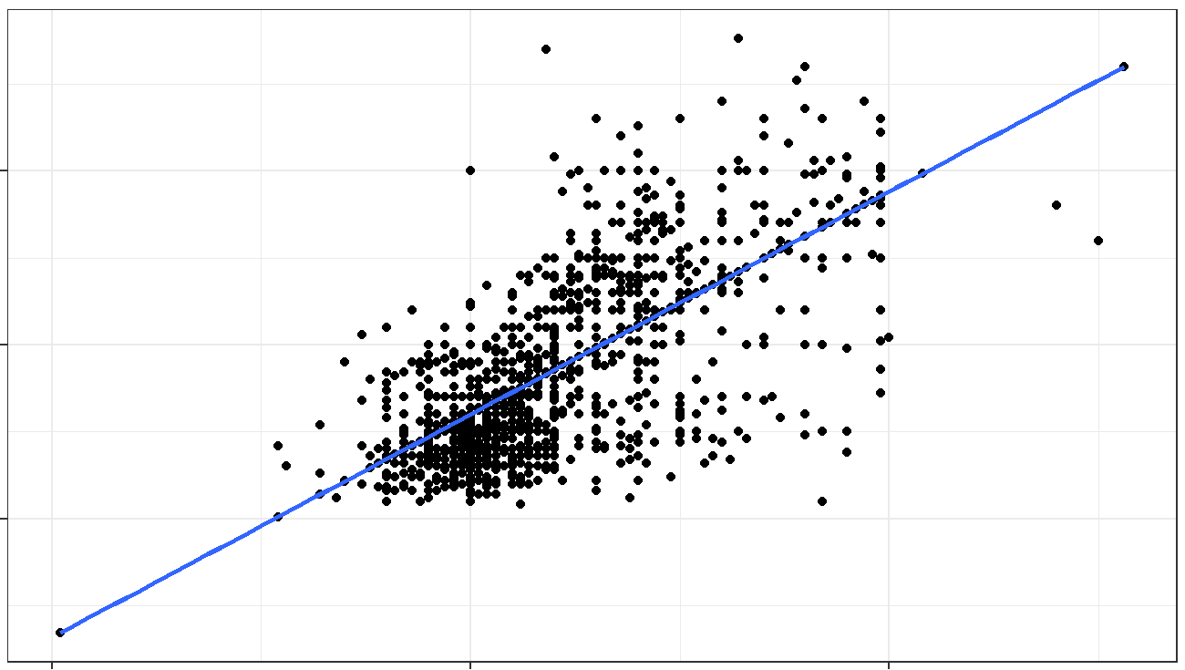
ABV and IBU correlation
100
International Bitterness Units of the beer
50
0
0.00
0.05
0.10
Alcohol volume of the beer

